Slide 1
the countercurrent flow mechanism works in fish respiration
2111614 张卓雅

Slide 2
In a countercurrent flow system, air (or, more usually the water containing dissolved air) is drawn in the opposite direction to the flow of blood in the gas exchanger.
(see lower diagram in Fig）.

Slide 3
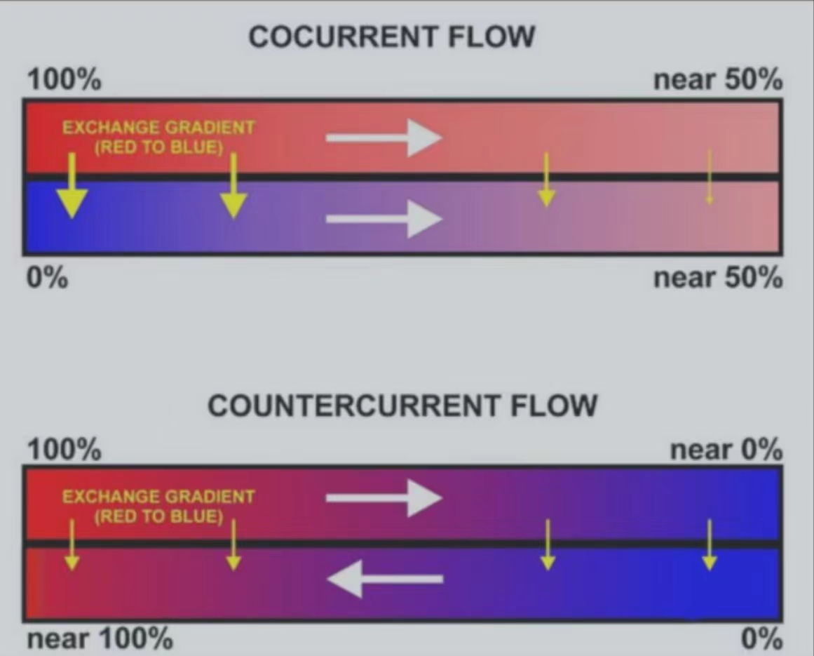
A comparison between the operations and effects of a cocurrent and a countercurrent flow exchange system is depicted by the upper and lower diagrams respectively. In both it is assumed (and indicated) that red has a higher value(e.g. of temperature or the partial pressure of a gas) than blue and that the property being transported in the channels therefore flows from red to blue. Note that channels are contiguous if effective exchange is to occur (there can be no gap between thechannels).

Slide 4
In multicellular organisms therefore, specialised respiratory organs such as gills or lungs are often used to provide the additional surface area for the required rate of gas exchange with the external environment.

Slide 5
This is the situation seen in the gills of fish and many other aquatic creatures. The gas- containing environmental water is drawn unidirectionally across the gas-exchange surface with
the blood-flow in the gill capillaries beneath flowing in the opposite direction.
Although this theoretically allows almost complete transfer of a respiratory gas from one side of the exchanger to the other, in fish less than 80% of the oxygen in the water flowing over the gills is generally transferred to the blood.

Slide 6
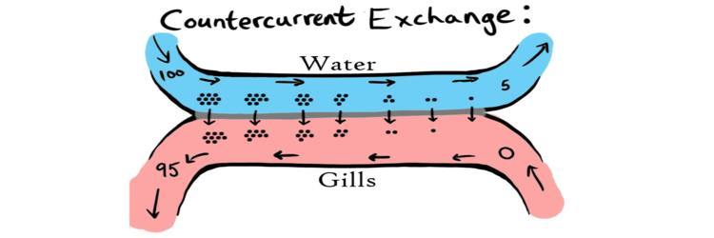
Countercurrent Exchange
In reality the blood flowing through lamellae travels in the opposite direction to the water passing over the gills. This ensures that a concentration gradient is maintained across the entire gas exchange surface. Oxygen deficient blood entering the gills is exposed to oxygen poor water that is about to leave the gills. Because this water still has slightly more oxygen than the neighbouring blood oxygen diffuses into the blood. As blood flows through the gills it continues to 'pick up' oxygen. As the blood oxygen concentration increases the blood also continues to encounter water with an even higher concentration of oxygen and thus a concentration gradient is maintained. Oxygen rich blood that is about to leave the gills (to go to respiring body cells) encounters the most oxygen rich water (water that has just entered the gills). This is much more efficient and allows a much higher proportion of the dissolved oxygen in water to be absorbed.

Slide 7
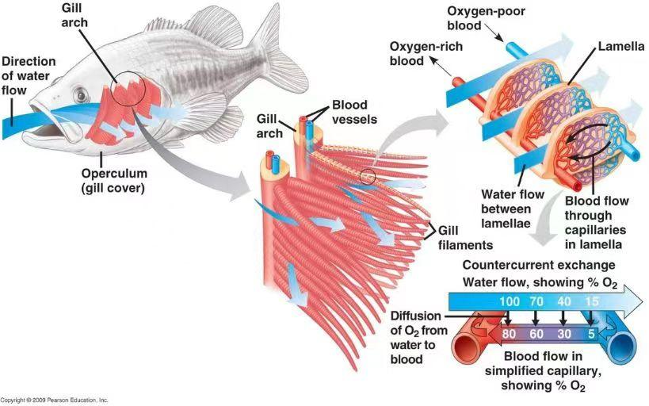
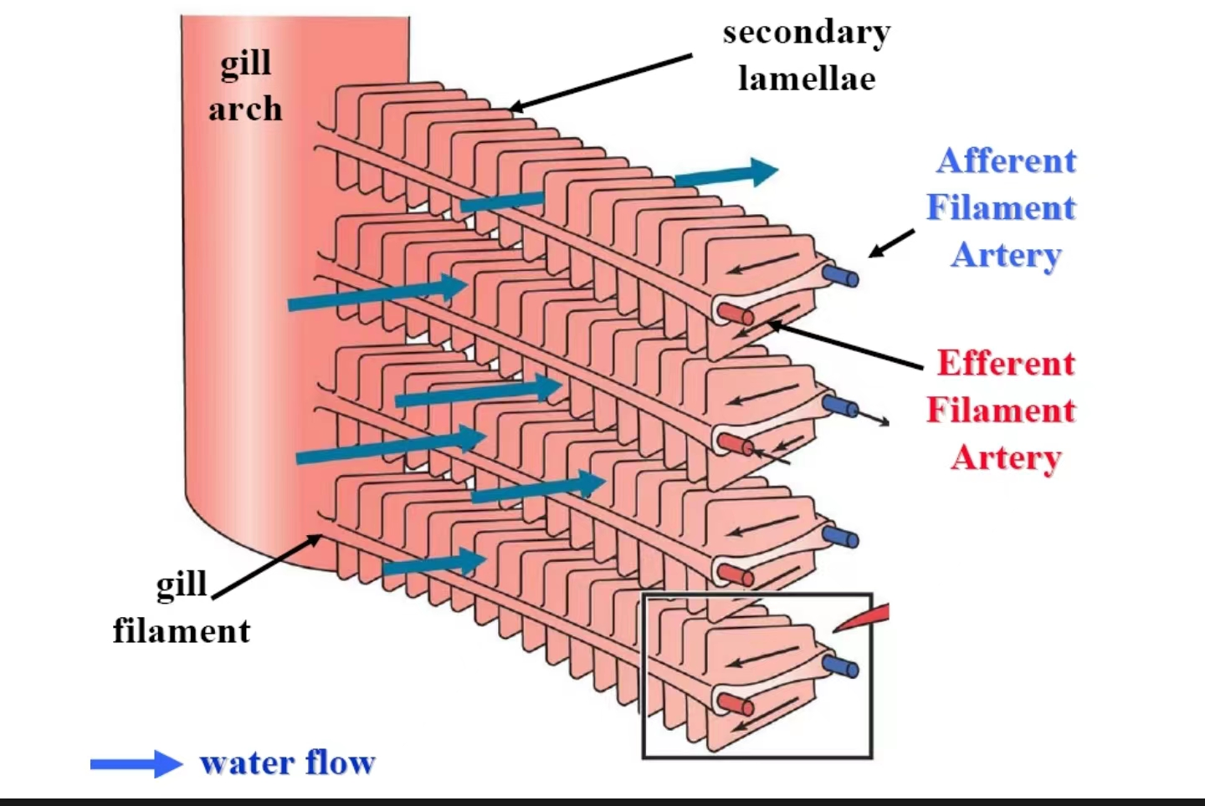

Slide 8
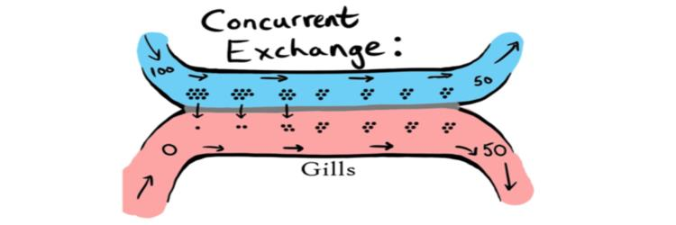
Concurrent Exchange
If blood flowed through the lamellae in the same direction as the water passing over the gills, only 50% (maximum) of the available oxygen could be utilised. Oxygen would diffuse down it's concentration gradient from an area of higher concentration (the water) to an area of lower concentration (the blood). However, as the water and blood continue to flow across the gas exchange surface an equilibrium would be reached with roughly equal concentrations of oxygen on either side of the gas exchange surface. At this point there would be no net movement of oxygen as there is no longer a concentration gradient.

Slide 9
Fish utilise a counter-current system in order to maximise the amount of oxygen that can extracted from water. Water has a much lower oxygen content than air and as such fish need a much more efficient system that can extract a much higher proportion of oxygen from the surrounding water.

Slide 10
THANKS FOR WATCHING

